Slide 1

SENTIMENT ANALYSIS USING US AIRLINE TWEETS
- Hrithika Charukula

Slide 2
Problem Statement
This project aims to extract the features of tweets and analyze the opinion of tweets as positive, neutral or negative.
Input : Textual content of a tweet
Output : Label signifying if the sentiment of the tweet is positive/negative/neutral

Slide 3
Dataset
The dataset is taken from https://www.kaggle.com/crowdflower/twitter-airline-sentiment
This dataset consists of 15 columns including the tweets and the sentiment of the tweets, which we’ll be using in our model building.
A total of 14640 tweets were used to train the model.

Slide 4
Model used for training
Multinomial Naive Bayes model is used for training the tweets.
Vectorization of tweets to proceed to training has been done using
- Bag of Words Vectorization
- TF-IDF Vectorization
The final UI is built using the TF-IDF Vectorization to transform the tweets since it also takes the meaning of the words into consideration.

Slide 5
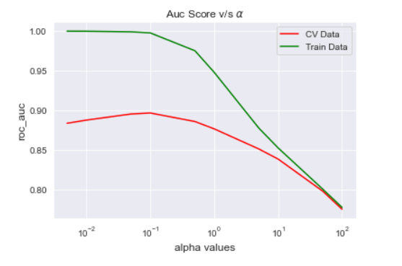
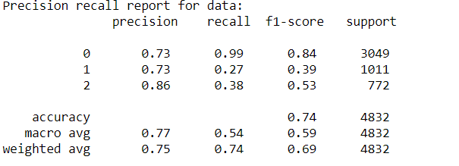
Performance metrics with Bag Of Words Vectorization

Slide 6
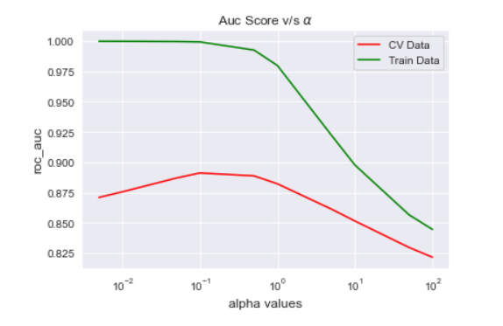
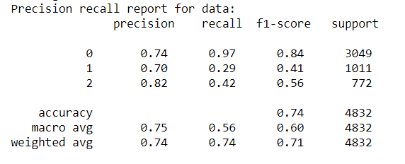
Performance metrics with TF-IDF Vectorization

Slide 7

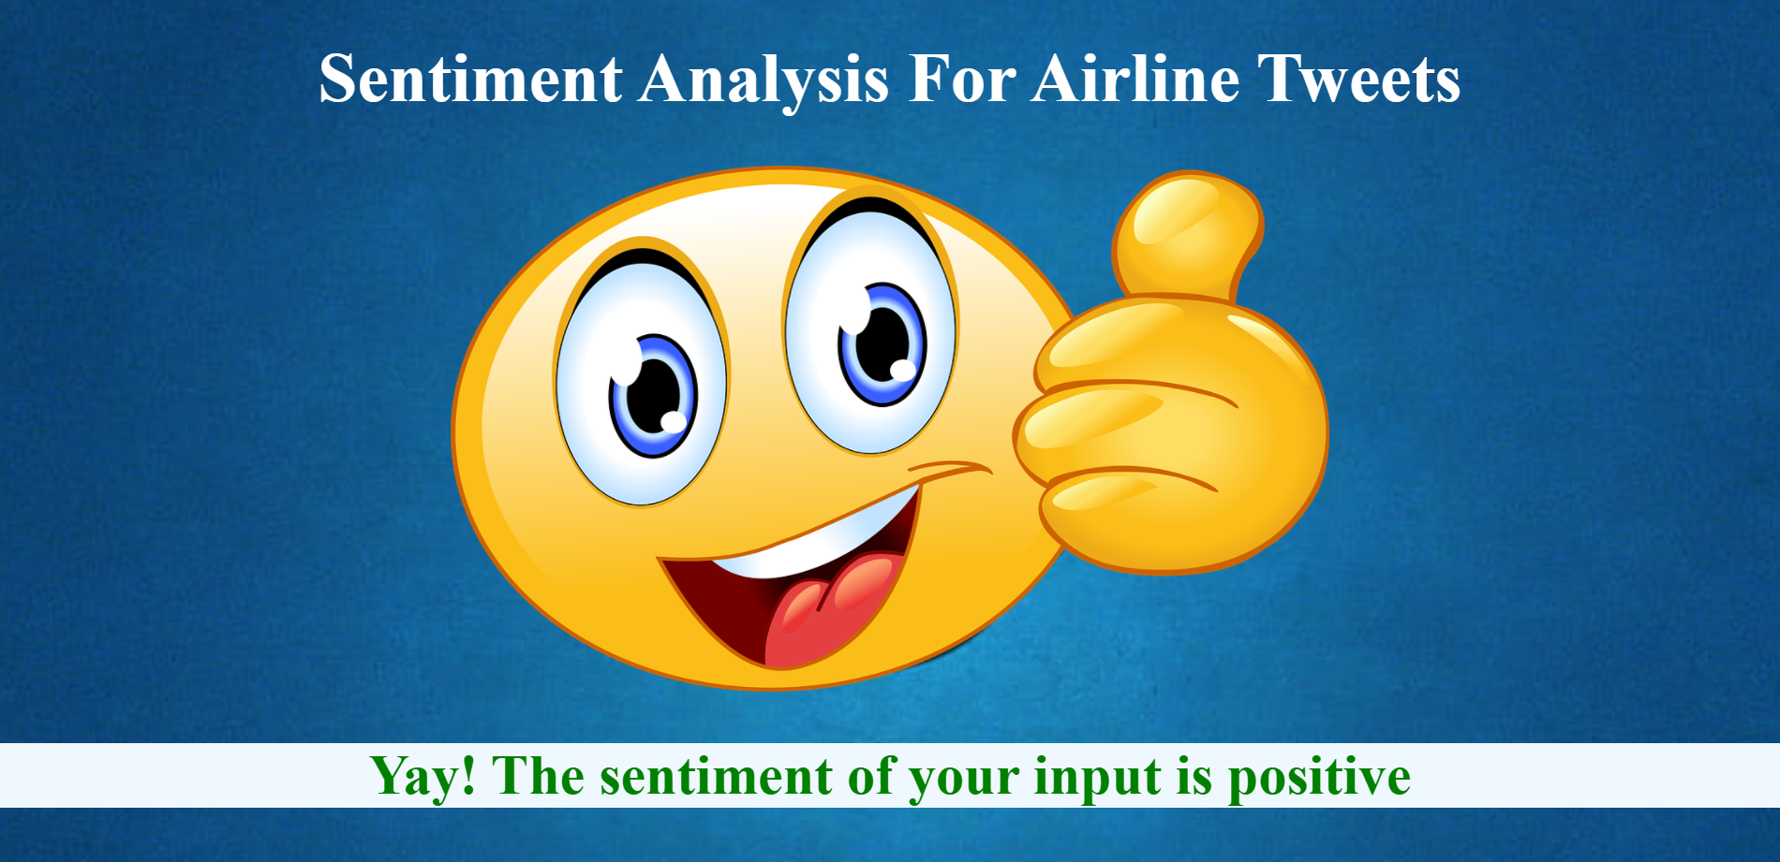
User Interface
Input Page
Output Page

Slide 8
THANK YOU

